Slide 1
Project 5:
Scheduling of Home Appliances for Handling of consumers’ electricity bill

Slide 2
Project Description:
In smart grid, dynamic pricing is a key element that manages the consumers electricity demand using some demand response programs. The smart grid provides facility to monitor consumers’ electricity demands. In peak timings, the price of per unit electricity is kept high in comparison to normal time. This is done to avoid failure of grid when the demand is high. Due to dynamic pricing, the consumers may get high bills if they do not use the appliances intelligently. In this project, you need to develop an algorithm for scheduling of appliances. Your algorithm will take the targeted electricity bill of a month and schedule the appliances. The algorithm will consider a penalty function for consumers’ discomfort. You may consider the home appliances of two types, namely controllable and uncontrollable. Controllable appliances are those which can be scheduled or controlled (e.g., washing machine). On the other hand, uncontrollable appliances cannot be scheduled (e.g., TV, refrigerator, computer, etc.).

Slide 3
Significance:
Modern power systems are evolving to a highly interconnected infrastructure called smart grid, which is an emerging technology that combines the traditional electricity supply infrastructure with information technologies.
Due to the recent advancements, the electricity usage of every moment in a building can be detected and then transferred to the utility company.
The utility company can adopt different price of electricity at each time slot of a day. The prices are usually higher during peak hours.
The rationale behind this is to shift the electricity demand away from the time of peak load, expecting a consumer-side reaction according to the change of prices.
In these situations, consumers can detect the price change and then reduce the electricity charges by controlling their own loads.
To achieve the full economic benefit of dynamic pricing, it is imperative that electric devices be equipped with an automatic price-aware scheduling mechanism that requires minimal action from the consumers.

Slide 4
Scheduling Algorithm

Slide 5
Approach
The existing real-time task scheduling problem is known to be a complicated optimization problem which is NP-hard, electricity usage scheduling is also a very complex problem to be optimized.
Finding an optimal schedule in an efficient way is not known, and it can only be found by enumerating all possible schedules and then evaluating them.
The complexity of the problem search domain is O(2^MN) where M is the number of tasks and N is the number of time slots.
For example, there are 23 electric devices to schedule, and if the scheduler needs to decide their on/off every 30 minutes, the number of possible schedules within a day reaches 2^(23*24*2) , that is, 2¹¹⁰⁴. Even with high-end computer systems, it is almost impossible to search all these schedules to find a schedule with the minimum electricity charges.
Thus, we have to go for approximate acceptable solution.

Slide 6
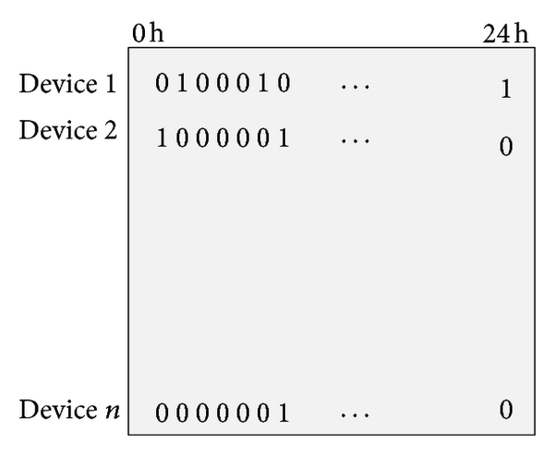
Input-Output Format
The targeted electricity bill for the month followed by number devices is taken as the first input.
Device ratings and the schedule for the operation of each device with maximum affordable delay are the next inputs.
The dynamic electricity price of each time slot is taken as an array. We have divided a day in 24 time slots thus assuming that the electricity price is updated every hour.
The output generated is represented as a matrix with rows representing the devices and column representing the time slots.
The value of each entry in the matrix can be defined
as 0 or 1; the value of 0 refers to the state that the
device is switched off, and 1 refers to the state that it
is switched on.

Slide 7
Logic:
Daily Target - The monthly target is equally divided into number of days in the month.
At first, a solution with no discomfort (discomfort is proportional to delay) is checked whether if it satisfy for the daily target. If yes, then this solution is accepted.
If the zero discomfort solution does not satisfy the target, then a fixed number of random solutions are generated and the one with minimum discomfort is accepted which satisfy the need as well as the target.
If no such solution is generated, then we accept a solution with minimum electricity bill howsoever high the discomfort may be.
Updating of balance amount – the balance amount from the daily target is adjusted in subsequent days.

Slide 8
Limitations:
There may exist a better solution than one provided by this algorithm, i.e., the solution fulfils the target with less discomfort penalty.
However, the algorithm stated above may be unable to find best possible solution because it is based on searching best from randomly generated solutions.

